Slide 1
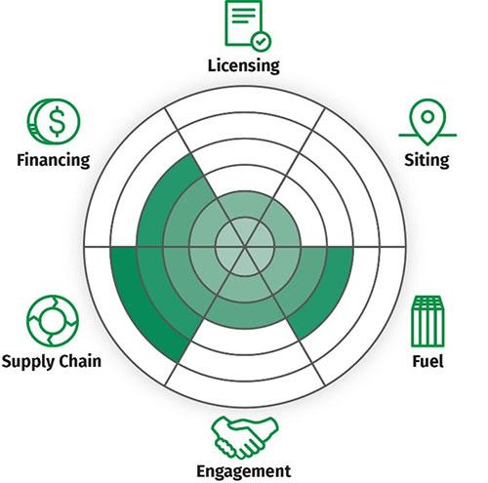
Financing and Investment Opportunities SMR Supply Chain First Nations Power Authority February 20, 2025

Slide 2

Overview
Introduction
First Nations Power Authority
The Ready 4SMR Series
SMR Opportunity
The Supply Chain
Opportunity
Certification
Financing
Indigenous Perspective

Slide 3



Introduction
Darren J. Huculak
Project Advisor to FNPA (Mushom!)
MA in Economics (University of Calgary … A long time ago, in a galaxy far, far away …)
Metis Heritage ( my Mom is up there watching me!)
Sports, travel, movies, reading, music
Background in renewables (hydro, solar, and wind); transportation (rail); and natural gas distribution economics, financing and commercial structures
Learning about SMRs too!
Approach to life in general and business:
“Decisions are Hard. They Shouldn’t be Complex”

Slide 4
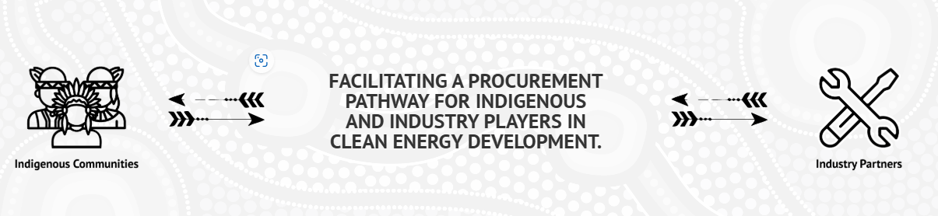
Introduction
First Nations Power Authority
Established in 2011
Indigenous owned, membership based, not-for-profit
Liaise between stakeholders in power sector to:
Support meaningful Indigenous participation energy
Provide diverse perspectives / technical knowledge through Indigenous lens
.Enhance independence by providing Indigenous communities with economic / social opportunities.
Leading advocate for Indigenous participation in the development of SMRs

Slide 5


Introduction
Ready for SMR
Partnership between FNPA, OCNI and SIMSA to prepare Saskatchewan businesses to participate in SMR supply chain.
Key Goals of Ready4SMR are to promote:
Economic Development
Capacity Building
Safety Culture
Indigenous Ownership
Jointly funded by CIC and PrariesCan
The last in the Webinar Series
Larger, in person event to upcoming in
Thank You!

Slide 6
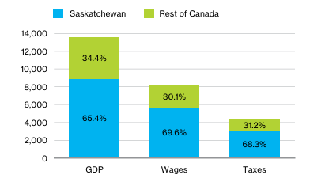
SMRs Are the Future
$8.8B in investment by 2042
Net Zero Future
Electricity demand will increase by 135% by 2050 → rapidly scale power fleet
There is no single energy source that can meet demand
Increasingly promising option is to commercialize small modular reactors (SMRs).
Saskatchewan Forecast Jobs
Manufacturing & Construction: 7,042/yr
Operations: 728/year
Project Development: 718/Year
Decommissioning: 833/year

Slide 7

SMR Supply Chain Key Components
Design and Licensing
Developing concept, carry out engineering work, and obtain permits
Time-consuming and expensive, it requires navigating complex regulations.
Manufacturing
Manufacture components like pressure vessels, steam generators, and control systems.
Construction
Encompasses site preparation, infrastructure development, and reactor assembly.
Operation and Maintenance
Safe efficient operations requires skilled operators, robust safety protocols, and effective maintenance
Decommissioning
The safe and responsible dismantling and disposal of the reactor and its components.

Slide 8
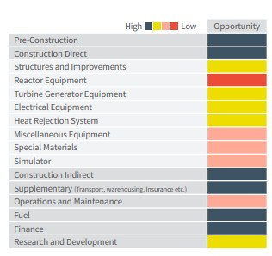
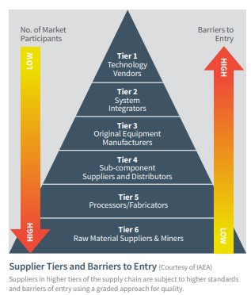
Supply Chain Opportunity Map
Heat Map
Market Tiers

Slide 9


Partnership is Key!
Team Canada Advantage
Canada has established supply chain for conventional nuclear assets
Uranium is mined and milled in northern Saskatchewan
Uranium is refined and consumed in Southern Ontario
Waste is managed in Manitoba, Ontario, Québec and New Brunswick
SMR Present Novel Challenges
Involve first-of-kind technologies and first-of-kind manufacturing methods.
Investment in supply chain is "critical" to advance SMR deployment in Canada
Canada’s existing supply chain must be “re-skilled” and “re-tooled”to meet unique SMR specifications and adapt to deployment involving modular construction with factory assembly.

Slide 10




Strategic Considerations
Standardization
Develop standardized SMR designs components to improve efficiency, reduce costs, and simplify the regulatory approval process.
Collaboration
Foster partnerships between governments, academia, and industry to accelerate innovation and reduce risks.
Workforce Development
Invest in education and training to build a skilled workforce to support various aspects of SMR supply chain
Supply Chain Resilience
Diversify suppliers and development of alternative sourcing strategies to mitigate the impact of disruptions

Slide 11

Tactical Requirements
Integrated Coordination
Develop terms of reference bringing together federal and provincial governments, owners and operators, end-users, and industrial suppliers
Identify needs for selected SMR technologies.
Develop a common forum identified to communicate future tenders and gauge Interest from suppliers to enter the SMR supply chain provide
Industry Readiness
Implement program to allow suppliers to measure their own operations against standards, and requirements to supply within the nuclear industry
Provide support for closing respective gaps.
Enable new SMR suppliers to gain experience under oversight of qualified mature suppliers
Inventory of assets available for SMR supply chain developed
Certification bodies established and resourced to qualify new and existing suppliers

Slide 12


Fit For Nuclear
UK Nuclear Advanced Manufacturing Research Centre unique service
Fit For Nuclear:
Lets companies measure operations against the standards required to supply the nuclear industry in new build, operations, and decommissioning –
Helps them take the necessary to close gaps identified
Focuses on supplier development small and medium-sized enterprises (SMEs).
Help smaller manufacturers understand what the market expects from them, what they may be capable of supplying, and where they sit in the nuclear supply chain (demystify the nuclear sector and remove barriers to entry)
To date, participants in supply chain development programs have reported winning more than £3.7 billion of new contracts steps to close any gaps.
Using this template, Canada could launch a program that coaches, trains, and advises businesses along the journey to becoming qualified to participate in the highly regulated and specialized nuclear industry.

Slide 13
Key to Participation → Certification!
ISO Standard Certification 19442
ISO 19443 first international standard created to ensure quality control through nuclear supply chain
Specifically addresses risks and regulations associated with nuclear safety (it goes beyond ISO 9001)
Enables organizations to demonstrate their quality management system (QMS) combines best practice against the specific requirements of the nuclear industry.
Benefits of Certification
Certification to ISO 19443 by an independent third-party verifies how your management system is performing, showing a commitment to effective quality management principles in organization.
Demonstrate compliance and commitment to nuclear safety culture.
Increases competitive advantage by meeting certification business requirements from customers, suppliers and sub-contractors.
Simplifies the evaluation and qualification of suppliers certified by the civil nuclear industry.
Maintain compliance with legal requirements and ensure that regulatory requirements are met.
Comply with the best quality practices with the specific requirements of the nuclear industry.

Slide 14
ISO Standard Certification 19442
Road to Certification
Obtain a copy of the standard to familiarize yourself with the requirements
Review literature and software to assist understanding of and implementation of the standard
Identify what is available and what could be of support in your implementation process
Assemble a team and define your strategy. Critical that this be a company wide decision, that senior management is involved, and that a team is dedicated to develop and implement the system
Determine training needs; team members that are responsible for implementing and maintain the management systems need to know full details of applicable standards
Review consultant options
Develop your management system documentation
Decide an appropriate platform for your management system documentation
Your management system should describe the policies and operations of your company.
The documentation includes relevant processes and other documented information needed to support you in meeting intended outcomes and requirements of the applicable standard. .

Slide 15
ISO Standard Certification 19442
Road to Certification
Determine, manage and document your processes. These processes should cover areas such as:
Product and service realization (operational processes)
Meeting relevant needs and expectations of customers and other stakeholders
Management processes, including measurement, analysis, improvement and innovation
Implement your management system
Consider a pre-assessment
In some case, you can choose to have a preliminary evaluation of the implementation of your management system by a certification body/registrar.
The purpose is to identify areas of non-conformance or weaknesses and allow you to correct these areas before you begin the accredited certification process.
Select certification body and resister
Business relationship with the certification body/registrar will exist for many years, as your certification has to be maintained.
To have an efficient management system, continual improvement is key.

Slide 16
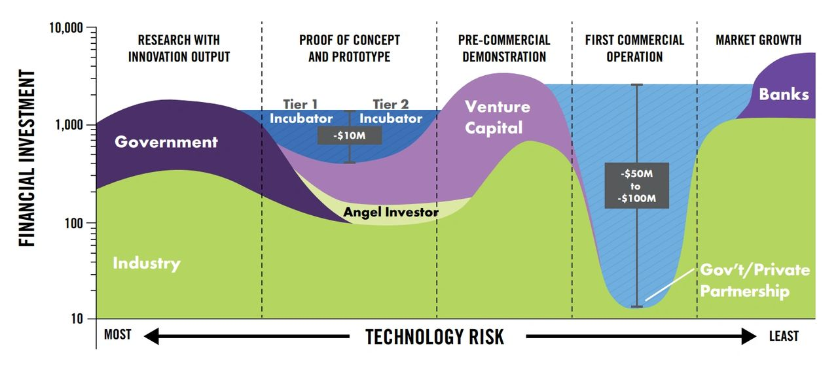
Financing?

Slide 17
Indigenous Participation
Time is of the essence
There will be no SMR industry without meaningful Indigenous participation
A call to Action!
Government and Industry must partner with First Nations to:
Identify and evaluate inventory of existing First Nation businesses that are seeking to participate in the SMR supply chain
Develop and implement training sessions specifically designed for First Nation owned entities
Partner with academic institutions to develop Indigenous based degree granting programs specific to the nuclear industry
Stand up an entity with the specific mandate of assisting First Nation entities to obtain ISO Certification
Provide direct funding and/or backstop necessary funding to become certified and develop skills to participate

Slide 18
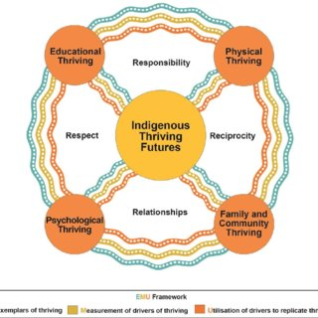
Thank You!
Discussion
Questions?

Slide 19
Thank You

