Slide 1
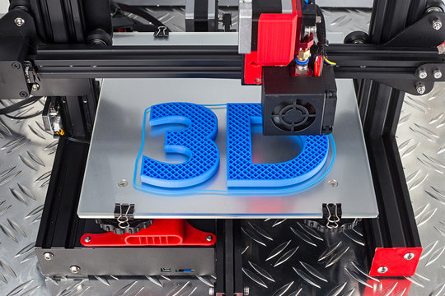


Advanced Manufacturing
In the Nuclear Industry

Slide 2

Land Acknowledgement
We would like to acknowledge that OCNI’s head office is situated on the traditional territory of the Mississauga Nation and the Treaty territory of Scugog Island, Curve Lake, Alderville, Hiawatha, Rama, Beausoleil, and Georgina Island First Nations. It was these 7 First Nations that Canada recognized when Williams Treaty was negotiated in 1923. We recognize these peoples and their ancestors as those who have inhabited these lands since time immemorial. All those who come to live and work here are responsible for honouring this treaty in the spirit of peace, friendship, and respect.
We are privileged to work and inhabit these lands, and with that privilege comes responsibility. As treaty people, we all share a collective responsibility to honor and uphold the treaty agreements, to acknowledge the painful truths about the impacts of colonization on Indigenous peoples, and to commit to a path of reconciliation.
Let us reflect deeply on the shared journey toward healing, understanding, and unity. We have a chance to learn, to listen, and to engage in conversations that contribute to fostering a more inclusive society.
Together, let's create a future where every day is an opportunity to learn, grow, and move forward in a better way.
www.ocni.ca

Slide 3



Introduction to OCNI Brian Fehrenbach
AGENDA
Overview of Advanced Manufacturing in Nuclear
In Depth Look at Advanced Manufacturing
Dr. Andre Pelletier
www.ocni.ca

Slide 4

About OCNI
The Organization of Canadian Nuclear Industries (OCNI) represents a broad range of Canadian nuclear suppliers – the majority of members are SME’s.
250 member companies /
15,000 highly skilled people increasing to 20,000 while Ontario refurbishment projects are underway
www.ocni.ca

Slide 5




Strategic Focus Areas
CONNECTION
CAPACITY
GLOBAL REACH
ADVOCACY
Enable knowledge sharing, networking, and collaboration
Support capacity development to meet industry demands
Enable supply chain members to strategically connect with international high growth markets
Advocate to create opportunity for a sustainable Canadian nuclear supply chain
Supplier Days
Golf Tournaments
ONA partnered, Supplier Engagement Program
Industry Outreach
Social Media Content
Monthly Newsletters
Membership Drive & Retention
Indigenous Engagement
Ready4SMR
Ready for Nuclear
Atlantic Canada Opportunities Agency (NB)
PrairiesCan (Saskatchewan)
Industry Assessment
OCNI Youth Shadow Council (OYSS)
Participation in career fairs
Trade Missions
International & Global Conference support and attendance
Global relations
Industry focused events
Strategy Corp planning to meet with government officials
Advocating at Federal, Provincial and Municipal levels
Industry Collaboration and Events
Bursaries

Slide 6
Complete application form
How to become a OCNI Member
Submit completed form to hello@ocni.ca
Wait for Board approval
www.ocni.ca

Slide 7
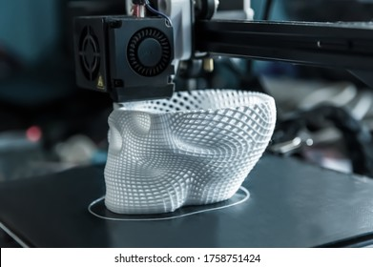
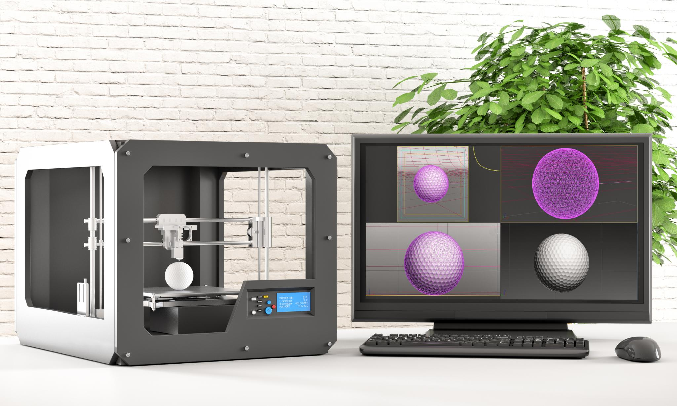
Advanced Manufacturing
Advanced manufacturing is defined as the use of innovative technologies and processes, such as automation, AI, and IoT, to improve efficiency, quality, and flexibility in production.
In the Nuclear Industry advanced manufacturing can be applied to creating new components, creating obsolete components (ie, CANDU refueling systems), design efficiency (digital twin), smart procurement and other areas.
The challenge remains demonstrating sufficient safety, quality and durability for operators and nuclear regulators to allow use in nuclear environments.
www.ocni.ca

Slide 8
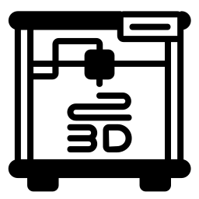



Advanced Manufacturing
Additive Manufacturing
Digital Twin
Artificial Intelligence
Hot Isostatic Pressing
Additive manufacturing (AM) is the industrial production name for 3D printing, a computer-controlled process that creates three dimensional objects by depositing materials, usually in layers. 3d printing materials include plastics, powders, resins, metal and carbon fibre.
A digital twin is a virtual model of a real-world object, system or process that can use real-time data to simulate behaviour. Used more in the design and planning stages, this process allows for higher certainty of design which can reduce manufacturing times and cost.
Artificial Intelligence can assist or improve advanced manufacturing by improving efficiency, reducing costs and increasing quality. A factory can also link their manufacturing directly with a smart supply chain.
Hot Isostatic Pressing (HIP) is an advanced manufacturing process that uses high heat (up to 2200 C) and high pressure (up to 45,000 psi) to improve material properties (density, porosity, etc.), bond materials or repair defects.

Slide 9
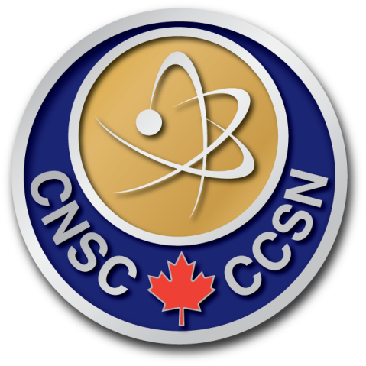



Advanced Manufacturing –
Who approves it?
Canada's nuclear regulator uses a risk-based approach to determining the appropriate level of safety/quality code/inspections. Our nuclear licensed facilities can undertake to demonstrate the suitability/safety of a proposed exception or modification that would otherwise not be compliant.
Grants ‘license to operate’ which includes requirements on the material properties, procurement and manufacturing of nuclear components.
Creates, manages and updates most quality standards applied to design, manufacturing or procurement of nuclear items in Canada.
Canadian nuclear utilities prescribe the quality standards they require for all design, manufacturing, procurement and installation.
Nuclear Quality Standards vs Technical Specificaitons
Technology vendors and engineering companies can undertake to demonstrate the benefit or safety of a ‘non-compliant’ item, such as a process or a component, for their client to approve.
www.ocni.ca

Slide 10
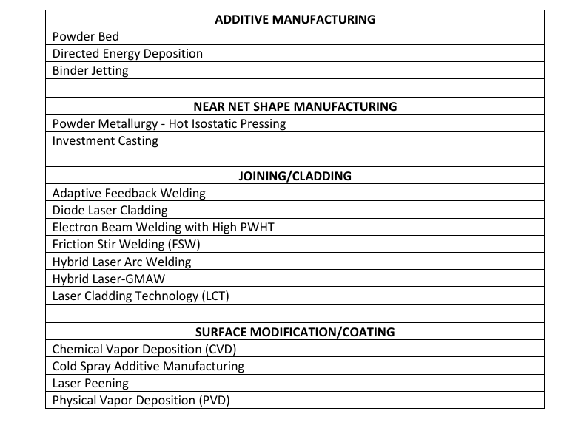
Advanced (Physical) Manufacturing
A number of Industry Roadmaps have been published:
OCNI-CAMiNA
US DOE NE - Advanced Materials and Manufacturing Technologies 2022 Roadmap
EPRI - Advanced Manufacturing Methods Roadmap for the Nuclear Energy Industry (3002022978)
NUCOBAM
Roadmap for Regulatory Acceptance of AMM in the Nuclear Energy Industry - Published in 2019
  Table 1 is short list of technologies assessed and reflects stakeholder preferences (Appendix A much more exhaustive list)
www.ocni.ca
Notes:
Sheffield Forgemasters claim welding breakthrough - World Nuclear News
Using Electron Beam Welding, the company weld-joined two 200mm-thick, 3-metre diameter vessel sections in UK small modular reactor nuclear grade steel, describing it as a breakthrough in the industrialisation of EBW for thick-section materials.

Slide 11
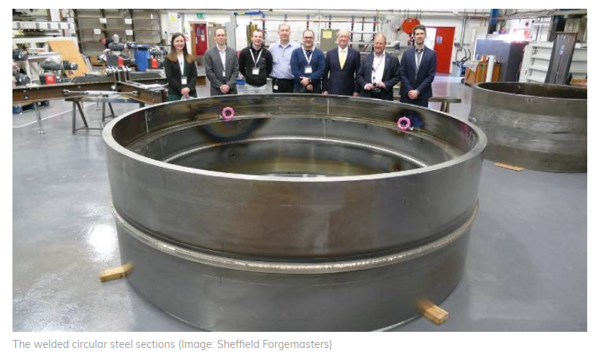
Welding – Still Prominent
Additive, digital and AI might get all the hype, but welding is still essential:
Tens of thousands of KM worth of welding wire needed in a nuclear power plant
A single joint between thick-walled components can require over 100 weld passes
Welding the vessels that contain the reactor core can take over a year using conventional techniques
Recent advances in welding technologies:
Sheffield Forgemasters claim welding breakthrough - World Nuclear News
www.ocni.ca
Notes:
Using Electron Beam Welding, the company weld-joined two 200mm-thick, 3-metre diameter vessel sections in UK small modular reactor nuclear grade steel, describing it as a breakthrough in the industrialisation of EBW for thick-section materials.
The weld, equivalent to approximately 10 metres of length, was completed in 140 minutes. The company said such a weld would normally take months and include various stages of non-destructive testing as well as heat treatment.
The EBW process uses local vacuum and a high-power electron gun which penetrates the vessel material with an electron beam, to melt and fuse the two components together in one go, rather than building up multiple layers of weld filler wire.

Slide 12
Additive Manufacturing -
Advantages & Disadvantages
Advantages
Design Flexibility
Material Efficiency
Cost and Time Savings
Enhanced Performance
Obsolescence
Material Innovation
Disadvantages
Material and Process Limitations
Regulatory Hurdles
Technological Barriers
Economics
Operational and Safety Risks
Knowledge (but really skills) Gap
www.ocni.ca
Notes:
Advantages
1. Design Flexibility
Complex Geometries: AM enables the creation of intricate and optimized designs that are challenging or impossible to achieve with traditional manufacturing methods.
Customization: Components can be tailored for specific reactor designs or unique operational needs.
2. Material Efficiency
Reduced Waste: AM uses material only where needed, minimizing waste compared to subtractive methods like machining.
3. Cost and Time Savings
Prototyping: Rapid production of prototypes allows faster design iteration and validation.
Shorter Supply Chains: Localized production reduces dependence on global supply chains and long lead times for custom parts.
Spare Parts: On-demand manufacturing of replacement parts avoids large inventory costs.
4. Enhanced Performance
Optimized Components: Design freedom allows for enhancements like better heat transfer, reduced weight, or improved mechanical properties.
Lattice Structures: Lightweight yet strong designs can improve performance in applications like heat exchangers or structural supports.
5. Revitalization of Legacy Systems
Replacement Parts for Older Systems: AM can reproduce parts for legacy reactors where original manufacturing tools or suppliers are unavailable.
6. Material Innovation
New Alloys: AM processes can use advanced materials, including custom alloys designed for high radiation and temperature resistance.
1. Material and Process Limitations
Material Qualification: Only a limited range of materials is currently compatible with AM processes, and many need rigorous testing for nuclear-grade certification.
Inconsistent Properties: AM components may have variable density or residual stresses, leading to concerns about reliability and long-term performance.
2. Regulatory Challenges
Certification and Licensing: The nuclear industry is highly regulated, and the qualification of AM parts involves extensive testing and documentation, which can delay deployment.
Uncertainty in Standards: The industry lacks comprehensive standards for AM in nuclear applications.
3. Technological Barriers
Surface Finish and Accuracy: AM parts often require post-processing to achieve the surface quality and dimensional accuracy demanded by nuclear applications.
Size Limitations: Current AM machines may struggle to produce very large components, which are common in nuclear reactors.
4. Economic Concerns
High Initial Costs: The upfront investment in AM equipment and training can be substantial.
Cost Competitiveness: For large-scale production, traditional manufacturing may remain more economical.
5. Operational and Safety Risks
Unknown Long-Term Behavior: AM components may behave differently under prolonged exposure to radiation, high temperatures, and corrosive environments typical in reactors.
Process Defects: Variations in the AM process can lead to defects such as porosity or micro-cracks, which are critical in the safety-sensitive nuclear industry.
6. Knowledge Gap
Skill Shortages: Specialized expertise is required to design, manufacture, and inspect AM parts, which may not be readily available in the nuclear workforce.

Slide 13
Additive in Nuclear –
Addressing the Gaps
How Radiation Affects Additive Parts - ADAPT – Alliance for the Development of Additive Processing Technologies
Investigation of the irradiation effects in additively manufactured 316L steel resulting in decreased irradiation assisted stress corrosion cracking susceptibility - ScienceDirect
Impact of sub-grain structure on radiation resistance in additively manufactured 316L stainless steels: An atomic insight into the mechanism - ScienceDirect
www.ocni.ca
Notes:
Neutron embrittlement, sometimes more broadly radiation embrittlement, is the embrittlement of various materials due to the action of neutrons. This is primarily seen in nuclear reactors, where the release of high-energy neutrons causes the long-term degradation of the reactor materials. The embrittlement is caused by the microscopic movement of atoms that are hit by the neutrons; this same action also gives rise to neutron-induced swelling causing materials to grow in size, and the Wigner effect causing energy buildup in certain materials that can lead to sudden releases of energy.
Neutron embrittlement mechanisms include:
Hardening and dislocation pinning due to nanometer features created by irradiation
Generation of lattice defects in collision cascades via the high-energy recoil atoms produced in the process of neutron scattering.
Diffusion of major defects, which leads to higher amounts of solute diffusion, as well as formation of nanoscale defect-solute cluster complexes, solute clusters, and distinct phases.[1]
Nuclear reactions: Neutrons cause nuclear reactions that change the material's chemical composition
Gas production: Some reactions produce gases, like helium, which can cause swelling and embrittlement
What it affects
Reactor materials
Neutron embrittlement can affect the materials in nuclear reactor pressure vessels, especially in the "beltline" near the reactor fuel
Consequences
Decreased fracture toughness
Neutron embrittlement can cause materials to lose fracture toughness and ductility
Limited service life
Neutron embrittlement can limit t
Tough RPV base metals that are typically used are A302B, A533B plates, or A508 forgings; these are quenched and tempered, low-alloy steels with primarily tempered bainitic microstructures. Over the past few decades, RPV embrittlement has been addressed by the use of tougher steels with lower trace impurity contents, the decrease of neutron flux that the vessel is subject to, and the elimination of beltline welds. However, embrittlement remains an issue for older reactors.

Slide 14
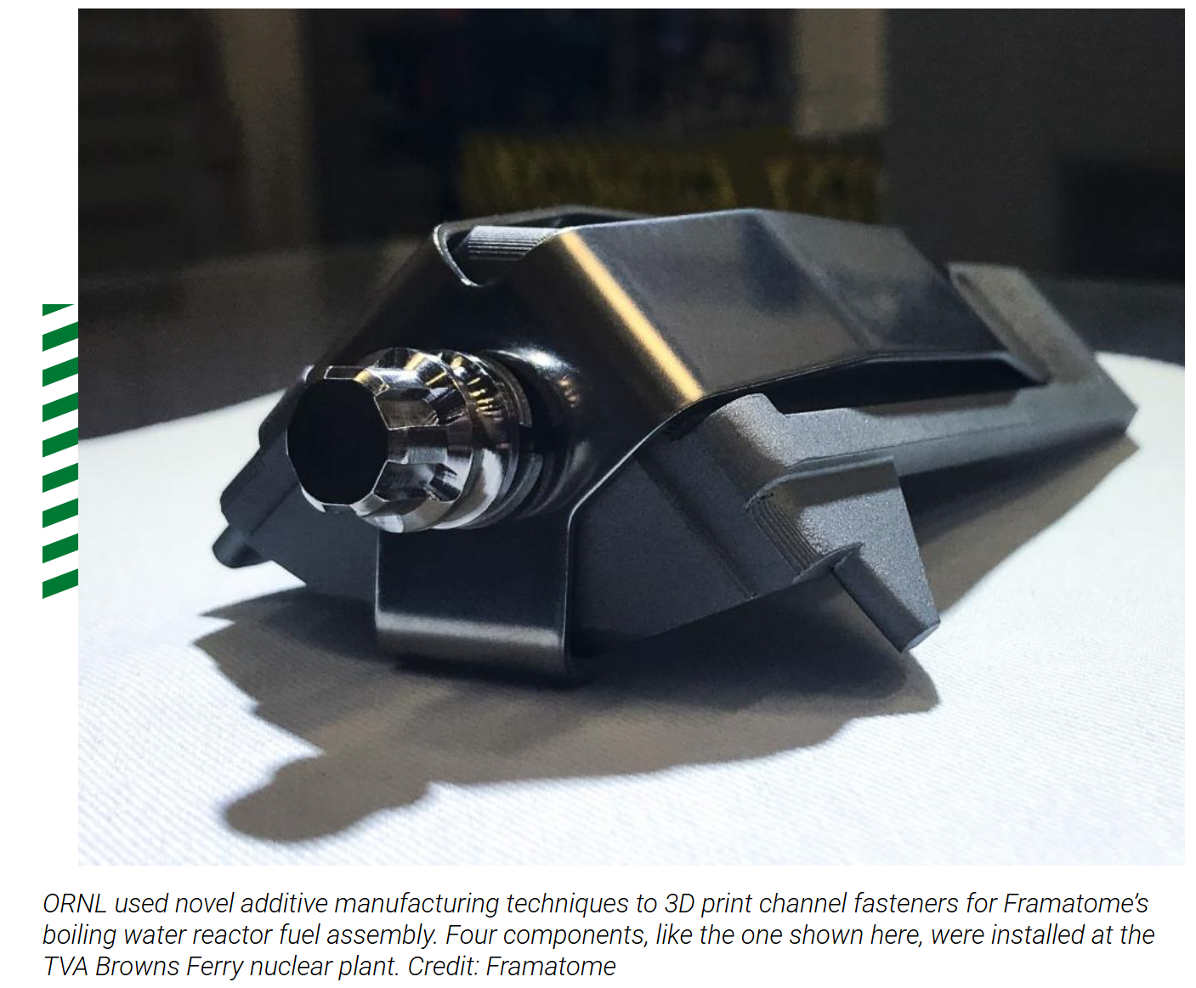
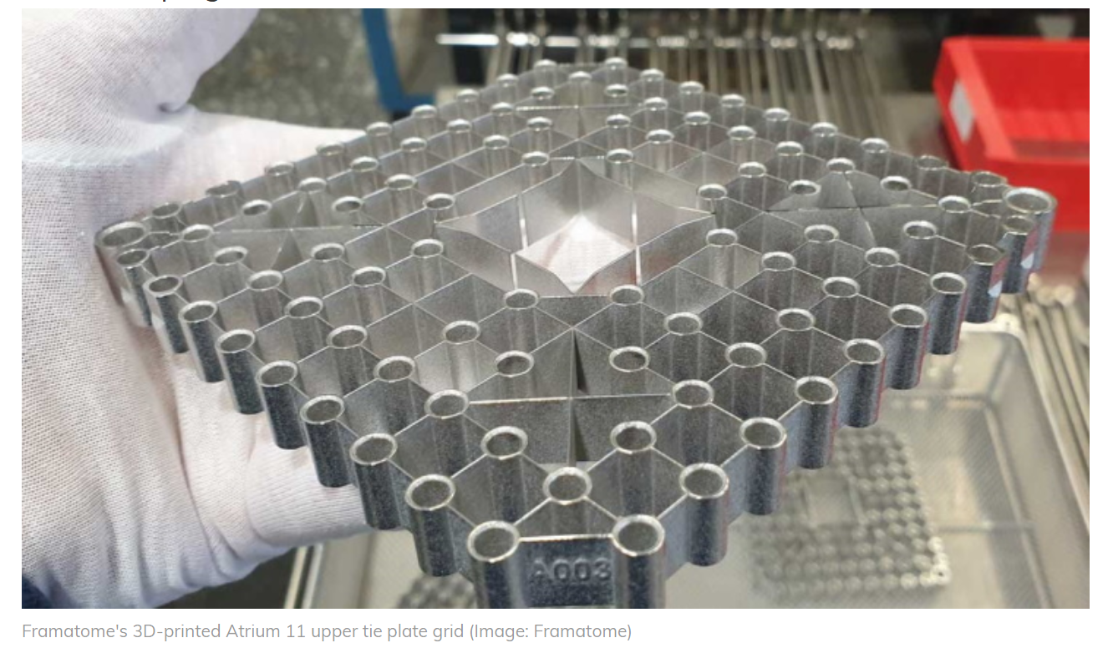
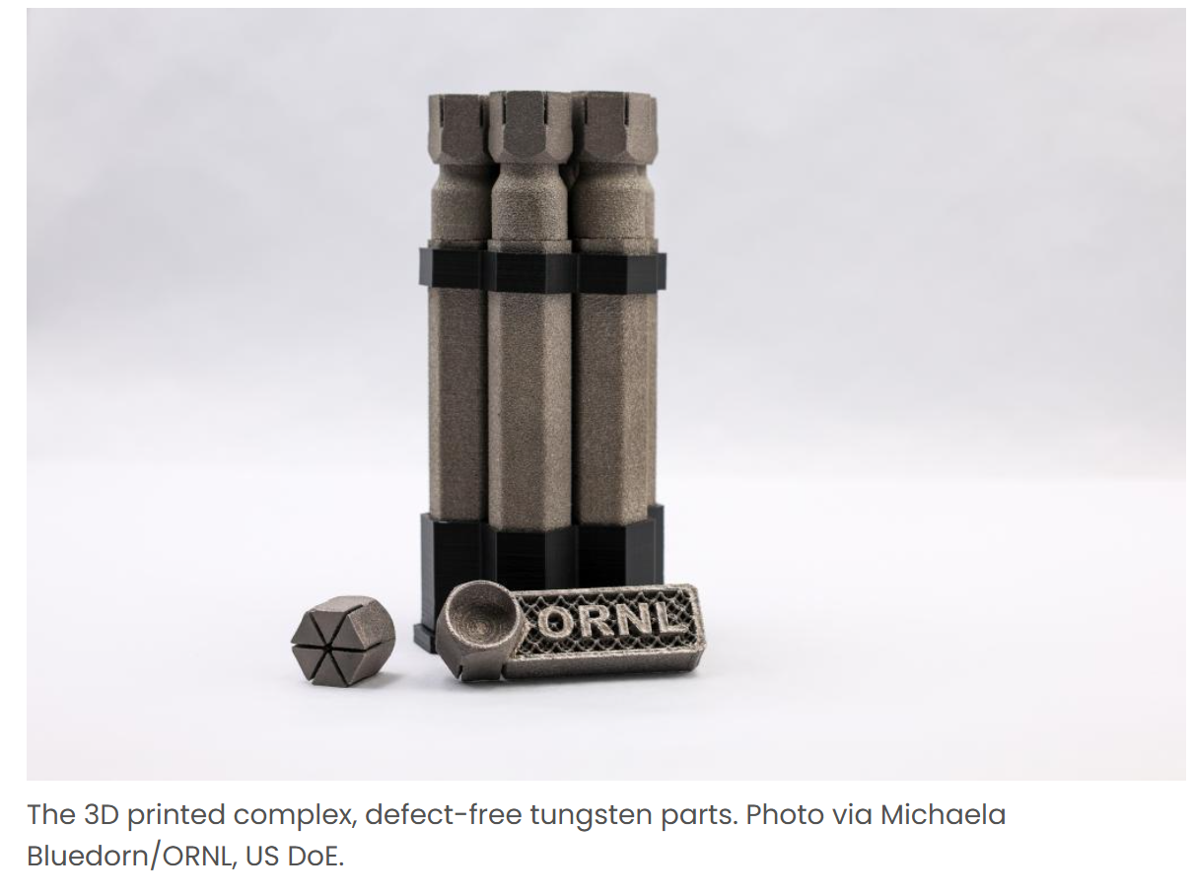
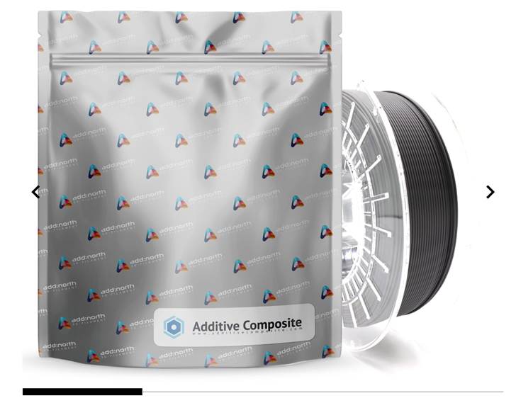
Additive in Nuclear –
Real World Applications
3D-printed fuel parts complete initial irradiation cycle - World Nuclear News (world-nuclear-news.org)
Nuclear reactor components 3D printed by ORNL now installed at TVA Browns Ferry nuclear plant
3D-printed fuel component installed at Swedish reactor - World Nuclear News (world-nuclear-news.org)
ORNL 3D prints new complex, defect-free tungsten components in "world first" - 3D Printing Industry
Swedish companies release radiation-shielding boron carbide filament | VoxelMatters - The heart of additive manufacturing
www.ocni.ca
Notes:
Fuel elements produced by Framatome using 3D printing technology have completed the first cycle of irradiation at the Gösgen nuclear power plant in Switzerland. These experimental stainless steel and nickel-based alloy components were installed in the 1010 MWe pressurised water reactor in 2019 for a five-cycle programme as part of a qualification project. Framatome said the fuel elements irradiated in the Gösgen plant will be further examined to confirm behaviour in real operating conditions.
(Image: Framatome)
The additive manufacturing project was initiated in 2015 at Framatome's prototyping laboratory in Erlangen, Germany. It focuses on additive manufacturing for stainless steel and nickel-based alloy fuel assembly components. The project involves Framatome fuel experts from France, Germany and the USA, in close collaboration with customers worldwide. Framatome said the project is also supported by the European Union and US Department of Energy programmes and relies on international laboratories and companies recognised for scientific advances in additive manufacturing.
Four first-of-a-kind 3D-printed fuel assembly brackets, produced at the Department of Energy’s Manufacturing Demonstration Facility at Oak Ridge National Laboratory, have been installed and are now under routine operating conditions at the Tennessee Valley Authority’s Browns Ferry Nuclear Plant Unit 2 in Athens, Alabama.
Researchers at the US Department of Energy (DoE)’s Oak Ridge National Laboratory (ORNL) have 3D printed defect-free tungsten parts with complex geometries.
Produced using electron-beam additive manufacturing at the ORNL’s Manufacturing Demonstration Facility (MDF), these tungsten parts are said to be the first of their kind. According to the ORNL team, this accomplishment offers significant potential for clean energy technologies, such as fusion energy.
Framatome has completed the installation of the first 3D-printed, stainless steel fuel component at Vattenfall's Forsmark nuclear power plant in Sweden. In collaboration with German pump and valve manufacturer KSB, the Atrium 11 upper tie plate grids were designed, manufactured, and installed in Forsmark unit 3 for a multi-year irradiation programme. in 2022
Fused Filament Fabrication and Fused Deposition Modeling

Slide 15
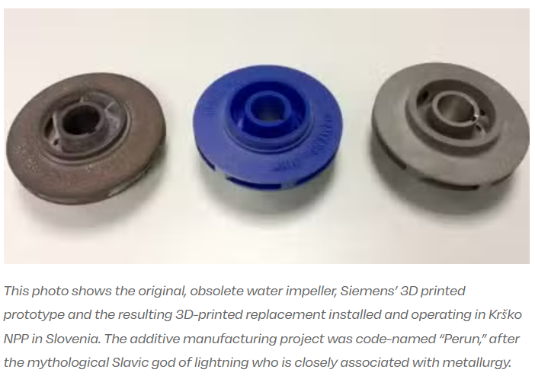
Additive in Nuclear – Obsolescence
Siemens sets milestone with first 3D printed part operating in a nuclear power plant (voxelmatters.com)
COG obsolescence program
  Big focus of OCNI – CAMiNA report
Metrology is an important aspect of this application
www.ocni.ca
Notes:
Following the integration of 3D printing as part of its digital services portfolio, Siemens has achieved an industry breakthrough with the first successful commercial installation and continuing safe operation of a 3D printed part in a nuclear power plant. Achieving this qualification is a significant accomplishment because of the stringent safety and reliability requirements in the nuclear sector.
The replacement part produced for the Krško nuclear power plant in Slovenia is a metallic, 108mm diameter impeller for a fire protection pump that is in constant rotating operation. The water pump provides pressure for the fire protection system at the plant. The original impeller was in operation since the plant was commissioned in 1981; its original manufacturer is no longer in business. Obsolete, non-OEM parts are particularly well-suited for this new technology as they and their designs are virtually impossible to obtain. This technology thus allows mature operating plants to continue operating and achieving or, as in the Krško case, even extending, their full life expectancy.
Siemens operates a state-of-the-art AM production facility in Finspång where is has been advancing this technology since 2009. Siemens extensively uses AM for rapid prototyping and has introduced serial production solutions for the rapid manufacturing of small fuel mixers and for rapid repair of burner tips for mid-size gas turbines.
The first 3D printed burner component for a Siemens heavy-duty gas turbine has been in successful commercial operation in a power plant in Brno, Czech Republic, since June 2016. It has achieved 1,600 equivalent operating hours without causing any forced outages. For parts production in industrial gas turbines, the benefits of Siemens’ AM include an approximate 50 percent reduction in lead time and a 75 percent reduction in development time. Siemens recently announced it has finished its first full load engine tests for gas turbine blades completely produced using AM technology.

Slide 16
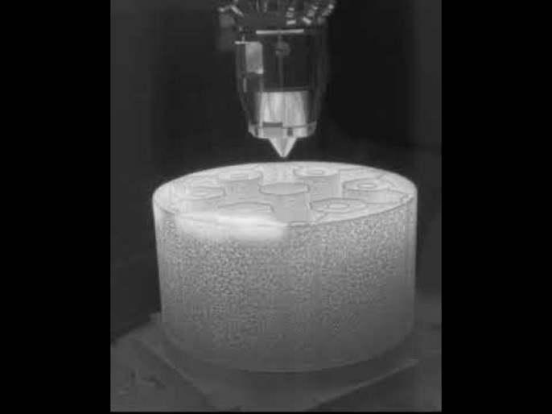
Additive in Nuclear – New Form Factors
www.ocni.ca
Notes:
The Transformational Challenge Reactor Demonstration Program uses thermal imaging to actively monitor the direct deposition of stainless steel to 3D print a component. Credit: Oak Ridge National Laboratory, U.S. Dept. of Energy
The hexagonal structure took close to 40 hours to build, with temperatures reaching over 1,400 degrees Celsius around the melt pool where a laser heats and melts while adding a new layer. Credit: Oak Ridge National Laboratory, U.S. Dept. of Energy

Slide 17
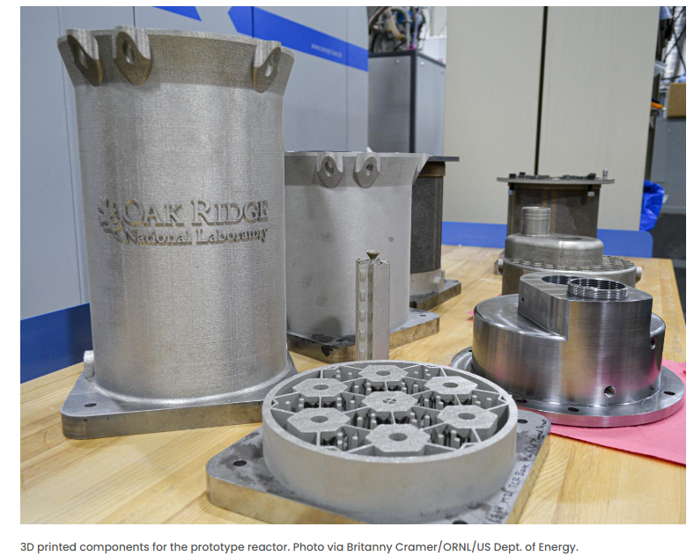
Additive in Nuclear – New Form Factors
www.ocni.ca

Slide 18
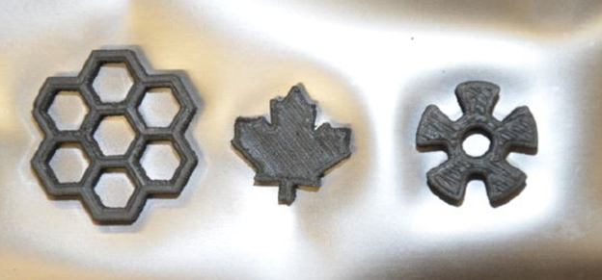
Additive in Nuclear –
News from CNL & Chalk River
A First for the Nuclear Industry: CNL Researchers Successfully 3D Print Using Uranium Dioxide - Canadian Nuclear Laboratories
Ultra Safe Nuclear Licenses New Method for 3D Printing Advanced Reactor Components | Department of Energy
MMR - Chalk River (usnc.com)
www.ocni.ca
Notes:
“We first began looking at 3D printing fuel in 2017 to produce new ceramic fuel designs to advance how fuel could more efficiently and safely perform in a reactor,” says James Crigger, an R&D Technical Officer in CNL’s Advanced Fuels & Reactor Physics Branch. “A conventional power reactor fuel is a pellet made by pressing UO2 powder into a cylindrical shape followed by sintering at high temperature. This process would be extremely difficult with intricate geometries (designs) given that it is already challenging to work with; ceramic is hard, brittle and melts at a very high temperature. Plus, 3D printed ceramic fuels had never been done.”
The team, led by former CNL researcher Andrew Bergeron, understood that these ceramic properties would be a challenge for 3D printing methods, which typically use heat to form model geometries out of filaments or powder. However, unlike plastic materials commonly used in 3D printing that melt around 200˚C, UO2 melts at 2,800˚C. Yet, even before testing UO2, the team had successfully 3D printed thorium dioxide (ThO2) parts – a relatively easier material to 3D print and is also used as a nuclear fuel and being considered for several novel reactor concepts. This research was supported under Atomic Energy of Canada Limited’s Federal Nuclear Science & Technology Work Plan and published in 2018.
Ultra Safe Nuclear Corporation (USNC) recently licensed a new method developed by Oak Ridge National Laboratory (ORNL) to 3D print refractory materials, which are highly resistant to extreme heat and degradation. The new technique will allow the company to significantly speed up its timeline to develop and deploy its advanced microreactor design. January, 24 2022
Oct 30, 2024 — Ultra Safe Nuclear Corporation says it is seeking to run a sale process after filing for Chapter 11 bankruptcy protection in the USA.

Slide 19
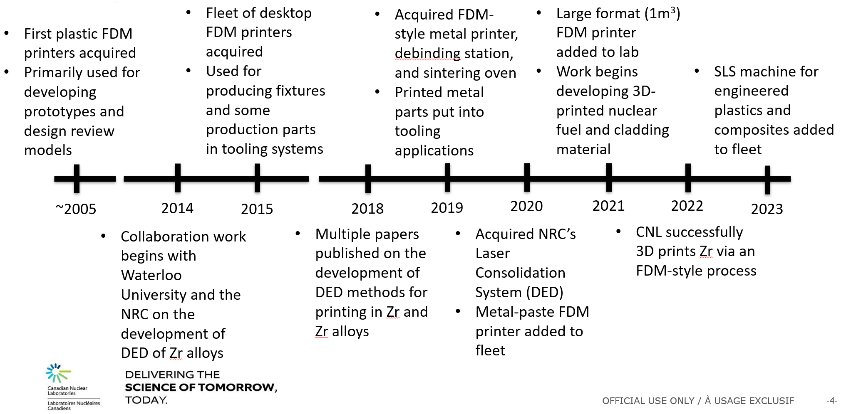
Additive in Nuclear – News from CNL
www.ocni.ca

Slide 20
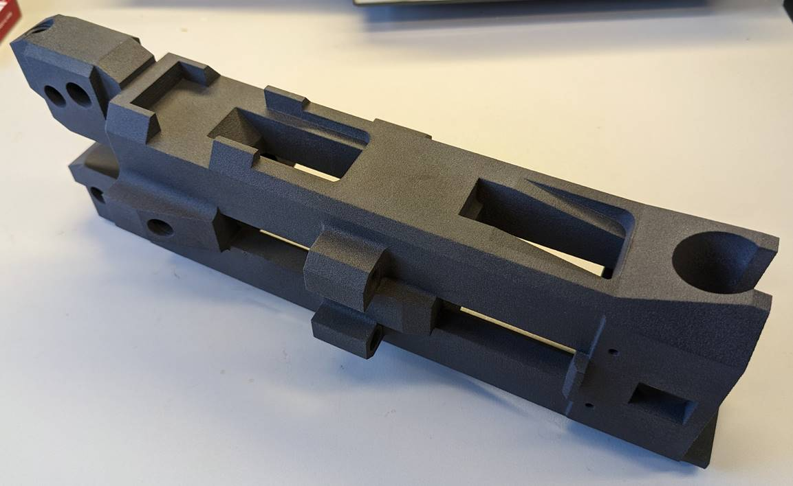

Additive in Nuclear – CNL Project Example
Tooling: Fuel Channel Tooling Component
Progress (presented in summer 2023 by Scott Read)
  Process selected (L-PBF)
  N299.3 requirements defined
  Similar process evaluated using Nylon-12 material (part currently in dimensional inspection)
  Metallic material powder sourced
  Manufacturing, inspection, and test plan in development
  Some features re-designed for better printability
  Areas where post-processing machining identified
Source: Scott Read
www.ocni.ca

Slide 21
Additive in Nuclear –
Canadian Workforce Development and Academic R&D Capacity
UNENE (University Network of Excellence in Nuclear Engineering)
  McMaster
  Ontario Tech
  Polytechnique Montreal
  Queen’s
  Royal Military College
  University of Guelph
  University of New Brunswick
  University of Regina
  University of Saskatchewan
  University of Toronto
  University of Waterloo
www.ocni.ca

Slide 22
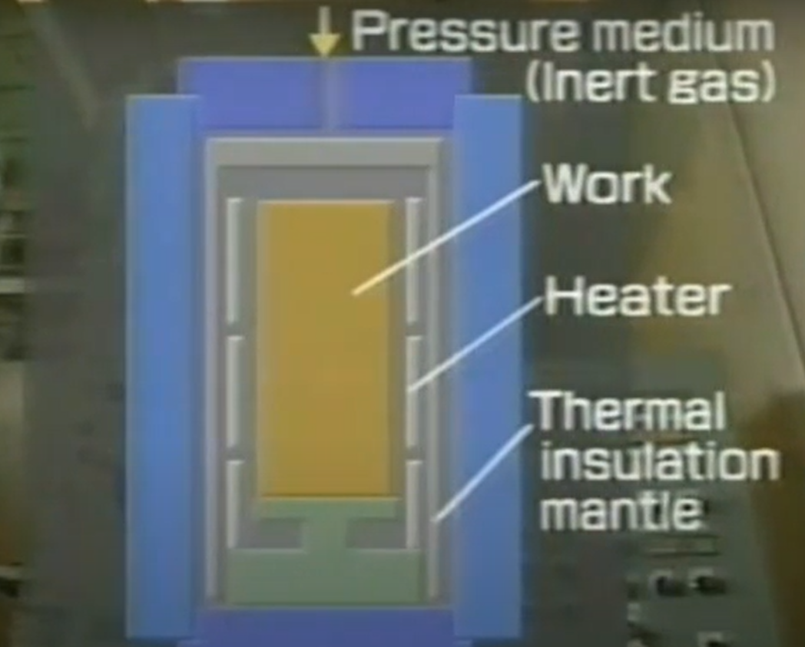
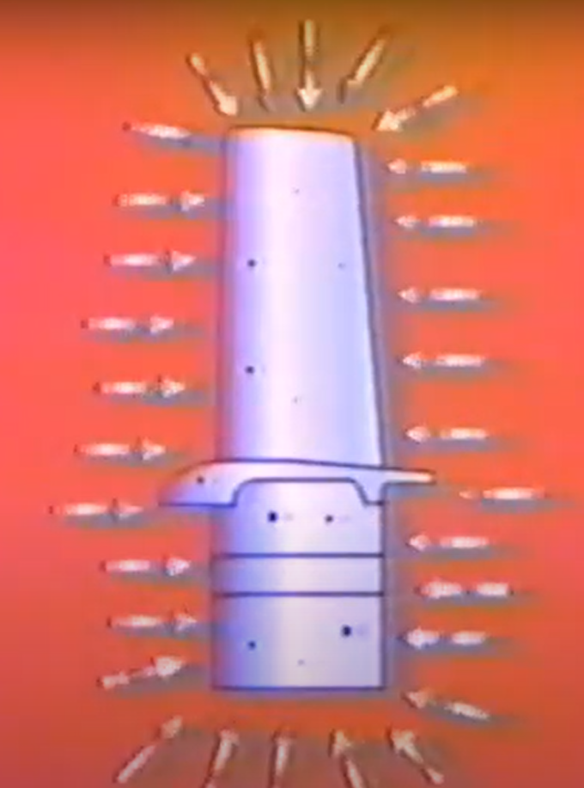
HIP
Hot Isostatic Pressing (HIP) has been used to remove shrinkage porosity and internal defects to improve mechanical properties and fatigue resistance in cast products (R&D started in the 1950s at Bettel Labs and commissioned by the AEC)
New applications in powedered metallurgy and AM (PM NNS & PM HIP)
Benefits of HIP
  Densification of powdered metal parts to 100% of theoretical density
  Total elimination of internal porosity in castings
  Improvement in mechanical properties:
    increased resistance to fatigue and temperature extremes
    higher resistance to impact, wear and abrasion
    improved ductility
  More efficient production:
    near net shape forming to precise tolerances
    little or no secondary machining or manual rework required
    reduce scatter ban in measured properties
    decreases scrap loss
The Use of Powder Metallurgy and Hot Isostatic Pressing for Fabricating Components of Nuclear Power Plants ORNL Report May 2022
Video produced by Produced by the Isostatic Pressing Association.https://www.youtube.com/watch?v=BsnzgsEXT_A&t=56s
www.ocni.ca
Notes:
Hot Isostatic Pressing (HIP) has been used to remove shrinkage porosity and internal defects for many years to improve mechanical properties and fatigue resistance in cast products. Research project from the 1950s.
Isostatic pressure in combination with heat is so powerful that canisters containing metal powders with a packing density lower than 70% can be completely densified to form solid metal blocks. The production of specially designed canisters can lead to predictive final shapes with extremely complex geometries, which are a viable option to forging, casting and additive manufacturing. The processing is referred to as Powder Metallurgy Near-Net-Shape (PM NNS), or Powder Metallurgy HIP (PM HIP).
This is an introduction to the technology of hot isostatic pressing (HIP), which is generally used to produce large PM parts to near-net shapes of varied complexity. The hermetic container for the powder is made of metal or glass and the pressurizing medium is a gas (inert argon or helium). At the elevated temperatures the process employs, the hermetic container deforms plastically to compact the powder within it. The combination of heat and pressure during the process eliminates the need for a supplemental sintering step.
For processing castings, metal powders can also be turned to compact solids by this method, the inert gas is applied between 7,350 psi (50.7 MPa) and 45,000 psi (310 MPa), with 15,000 psi (100 MPa) being most common. Process soak temperatures range from 900 °F (482 °C) for aluminium castings to 2,400 °F (1,320 °C) for nickel-based superalloys. When castings are treated with HIP, the simultaneous application of heat and pressure eliminates internal voids and microporosity through a combination of plastic deformation, creep, and diffusion bonding; this process improves fatigue resistance of the component. Primary applications are the reduction of microshrinkage, the consolidation of powder metals, ceramic composites and metal cladding. Hot isostatic pressing is thus also used as part of a sintering (powder metallurgy) process and for fabrication of metal matrix composites,[4] often being used for postprocessing in additive manufacturing.[5]
hot isostatic pressing is a form and densification process using heated gas under very high pressure unlike mechanical force which compresses workpiece from one or two sides isostatic pressure is applied uniformly
on all sides of an object eliminating porosity without changing its net shape the process can be used to treat pre-formed metal ceramic or composite parts and for compaction of containerized powder shapes over the
years hipping has proven its ability to significantly improve the physical properties of parts used in higher stress applications hipping provides the following specific benefits

Slide 23
HIP
Materials Commonly used in HIP
  Super alloys
  High speed steels
  Stainless steels
  Titanium and aluminum alloys
  Refractory metals
  Carbides
  Engineered polymers
  Advanced ceramics
  Cermets
  Ferrites
  Composite materials
www.ocni.ca

Slide 24
HIP for nuclear waste streams
UK Nuclear Decommissioning Overview
£117 billion projected expenditure over the next century.
Waste Management in England and Wales
Intermediate Level Waste (ILW) and High Level Waste (HLW) disposed of in a geological repository.
Wastes processed for passive safety via:
  Cementation (encapsulation in cement matrix).
  Vitrification (melting waste into boro-silicate glass).
  Challenges in Current Waste Treatment Methods
Cementation (ILW):
  Increases waste volume by up to 400%.
  Requires valuable repository space and adds transfer liabilities.
  Not suited for reactive metals (e.g., uranium), reducing stability and durability.
Vitrification (HLW):
  Preferred for HLW, immobilizing waste in glass.
  Being investigated for ILW but is a complex process.
  Challenges include:
    Precise control of melt parameters (viscosity, crystallization, conductivity).
    Volatile losses and complex off-gas systems.
https://researchfeatures.com/hot-isostatic-pressing-nuclear-waste/​
​
Hot-Isostatic Pressing (HIPing): A Promising Alternative
GeoRoc’s HIP Technology:
  Uses isostatic pressure and high temperature in a sealed vessel with inert gas (argon).
  Waste sealed in canisters, densified into stable, volume-reduced forms.
Key Advantages:
  Significant volume reduction.
  Potentially more stable wasteforms compared to cementation.
Implementation Progress:
  Conceptual plant design delivered to Sellafield.
  Successful trial: 160 L of sludge processed into a single 40 L HIP package.
  Viable alternative under consideration for ILW treatment.
www.ocni.ca
Notes:
The UK will spend around £117 billion on nuclear decommissioning within the next century. Of this, around 70% of the financial expenditure is predicted to be focused on Sellafield, the site of many ground-breaking nuclear developments in the 20th century.
In England and Wales, Intermediate Level Waste (ILW) and High Level Waste (HLW) (wastes exceeding 4 GBq / tonne α or 12 GBq / tonne β/γ) arising from current and historic nuclear operations, are to be disposed of at a single geological disposal facility, or repository. Prior to deposition, wastes are processed in order to be deemed passively safe using existing waste treatment methods, including cementation and melting into a glass wasteform (vitrification).
ILW is typically treated via cementation, which encapsulates the waste products within a cement matrix to contain the radioactive products. However, this process typically increases waste volumes by up to 400%, taking valuable repository space which may be costed by volume, and incurs additional waste transfer liabilities. The process is not ideally suited for all waste streams, for example the presence of reactive metals such as uranium may destabilise the cement, leading to reduced stability and durability.
Vitrification is the preferred option for high level wastes (HLW). It typically involves calcining the waste materials and melting with additives in order to immobilise radionuclides and chemotoxic elements within a boro-silicate based glass. Vitrification is also under investigation as a method for the treatment of ILW. Although vitrification offers a significantly reduced waste volume when compared to encapsulation, it is a complex process which requires exact control of process parameters such as the melt viscosity, crystallisation and conductivity, which are dependent on waste-stream composition. In addition, the processes involved may lead to greater radioactive volatile losses, more complex off-gas systems and additional secondary wastes.
Hot-Isostatic Pressing
GeoRoc’s Hot-Isostatic Pressing (HIPing) technology is potentially an exciting alternative treatment option for ILW wastes. HIPing is an existing method used to densify and consolidate materials by applying isostatic pressure at an elevated temperature in a pressure vessel. An inert gas, typically argon, is used to pressurise the heated vessel. For radioactive waste treatment, the waste is sealed inside a specially designed canister before HIPing. As the temperature and pressure inside the vessel increases, the materials placed in the canister react and densify to produce stable, volume reduced wasteforms.
A conceptual plant design detailing the treatment philosophy of these wastes has been delivered to Sellafield, supported by a trial demonstrating that over 160 L of sludge can be processed in a single waste package. This trial processed over 160 L of sludge into a single 40 L HIP package. Following the success of these two projects, GeoRoc’s process has become a viable alternative, under consideration for the treatment of ILW streams.

Slide 25
Advanced (non-Physical) Manufacturing
www.ocni.ca
Notes:
The UK will spend around £117 billion on nuclear decommissioning within the next century. Of this, around 70% of the financial expenditure is predicted to be focused on Sellafield, the site of many ground-breaking nuclear developments in the 20th century.
In England and Wales, Intermediate Level Waste (ILW) and High Level Waste (HLW) (wastes exceeding 4 GBq / tonne α or 12 GBq / tonne β/γ) arising from current and historic nuclear operations, are to be disposed of at a single geological disposal facility, or repository. Prior to deposition, wastes are processed in order to be deemed passively safe using existing waste treatment methods, including cementation and melting into a glass wasteform (vitrification).
ILW is typically treated via cementation, which encapsulates the waste products within a cement matrix to contain the radioactive products. However, this process typically increases waste volumes by up to 400%, taking valuable repository space which may be costed by volume, and incurs additional waste transfer liabilities. The process is not ideally suited for all waste streams, for example the presence of reactive metals such as uranium may destabilise the cement, leading to reduced stability and durability.
Vitrification is the preferred option for high level wastes (HLW). It typically involves calcining the waste materials and melting with additives in order to immobilise radionuclides and chemotoxic elements within a boro-silicate based glass. Vitrification is also under investigation as a method for the treatment of ILW. Although vitrification offers a significantly reduced waste volume when compared to encapsulation, it is a complex process which requires exact control of process parameters such as the melt viscosity, crystallisation and conductivity, which are dependent on waste-stream composition. In addition, the processes involved may lead to greater radioactive volatile losses, more complex off-gas systems and additional secondary wastes.
Hot-Isostatic Pressing
GeoRoc’s Hot-Isostatic Pressing (HIPing) technology is potentially an exciting alternative treatment option for ILW wastes. HIPing is an existing method used to densify and consolidate materials by applying isostatic pressure at an elevated temperature in a pressure vessel. An inert gas, typically argon, is used to pressurise the heated vessel. For radioactive waste treatment, the waste is sealed inside a specially designed canister before HIPing. As the temperature and pressure inside the vessel increases, the materials placed in the canister react and densify to produce stable, volume reduced wasteforms.
A conceptual plant design detailing the treatment philosophy of these wastes has been delivered to Sellafield, supported by a trial demonstrating that over 160 L of sludge can be processed in a single waste package. This trial processed over 160 L of sludge into a single 40 L HIP package. Following the success of these two projects, GeoRoc’s process has become a viable alternative, under consideration for the treatment of ILW streams.

Slide 26

Digital Twins
What are digital twins?
Digital twins are virtual replicas of physical objects, processes, and systems that can be used to optimize performance, reduce costs, and improve decision-making.
Technology behind digital twins
Digital twins rely on sensor networks and artificial intelligence to collect and analyze data, simulate scenarios, and predict outcomes.
Applications of digital twins
Digital twins are used in a variety of industries, including manufacturing, healthcare, transportation, and construction, to optimize performance, reduce downtime, and improve safety.
Benefits of Digital Twins
Digital twins can improve efficiency and productivity by enabling real-time monitoring and optimization of physical systems.
www.ocni.ca
Notes:
Digital twins are virtual representations of physical objects or systems that use real-time data to create a digital replica. They can be used to simulate, monitor, and optimize physical systems, resulting in improved efficiency and productivity. We will explore the basics of what digital twins are and why they matter.

Slide 27
Digital Twins – Use Cases
Optimizing Performance
Digital twins can be used to optimize performance by simulating and testing various scenarios before implementation, resulting in better outcomes and improved efficiency.
Reducing Downtime
Digital twins can reduce downtime by allowing for real-time monitoring and alerting of potential issues, enabling proactive maintenance and faster resolution of problems.
Improving Safety
Digital twins can improve safety by simulating dangerous scenarios and providing training to workers in a safe, virtual environment.
Predicting and Preventing Failures
Digital twins can be used to predict and prevent failures, resulting in significant cost savings by allowing for proactive maintenance rather than reactive repairs.
www.ocni.ca
Notes:
Digital twins are virtual representations of physical objects or systems that use real-time data to create a digital replica. They can be used to simulate, monitor, and optimize physical systems, resulting in improved efficiency and productivity. We will explore the basics of what digital twins are and why they matter.

Slide 28
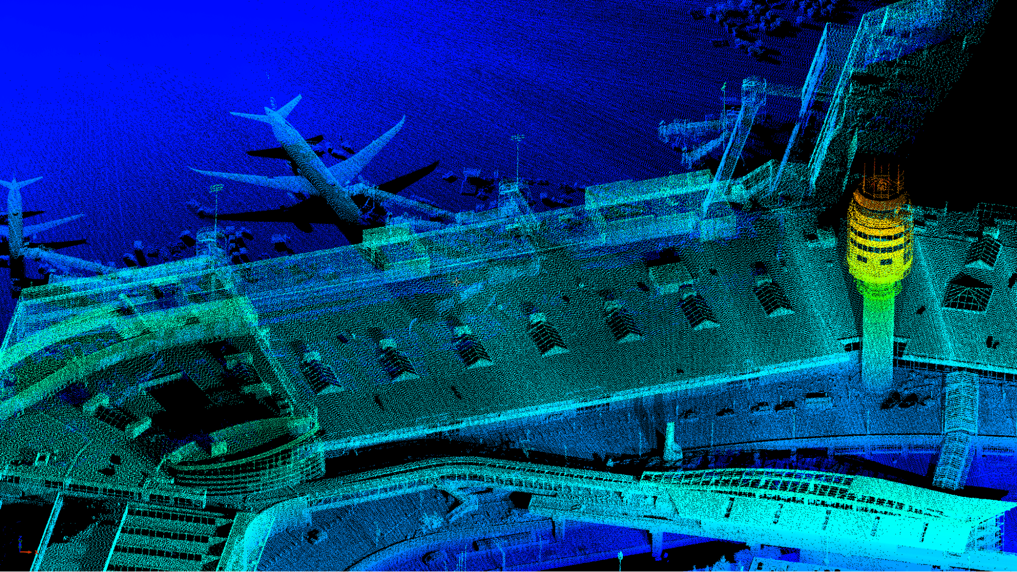
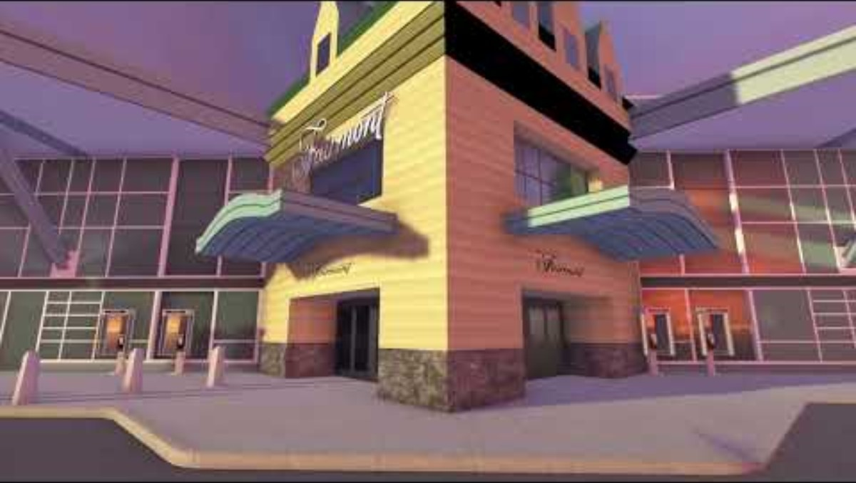
Digital Twins – Examples
Vancouver Airport
Worked with Unity to Develop a Digital Twin of its airport (notice the point cloud – metrology at scale!)
(Side note, Unity has some good knowledge content: https://learn.unity.com/tutorial/introduction-to-digital-twins-with-unity#)
Outcomes:​
Increased confidence in resource planning due to better forecasting​
Reduced time to conduct root-cause analysis for disruptions​
Improved decision making through enhanced situational awareness with access to real-time information
https://www.youtube.com/watch?v=8Hcv-HpSU_g&list=PPSV
www.ocni.ca
Notes:
The project
Creating an interactive representation of the airfield and terminal, connected to real-time operational data
The goal
Addressing facility challenges such as maintenance, sustainability, and safety while avoiding operational disruptions
Products and services
Unity
Team members
200 airport operations staff using the runtime application
Operational situational awareness for over 600 airport staff
Stakeholder engagement

Slide 29
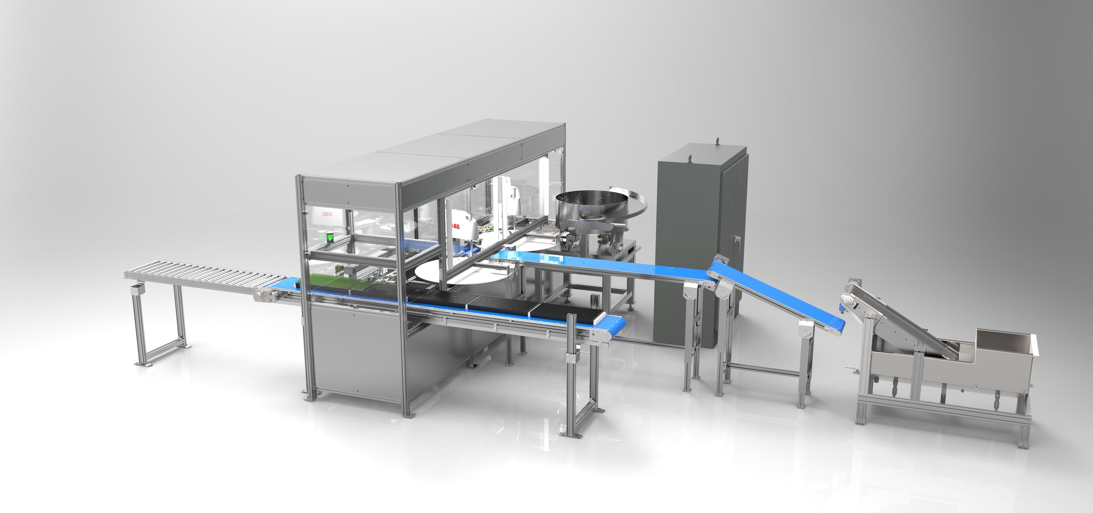
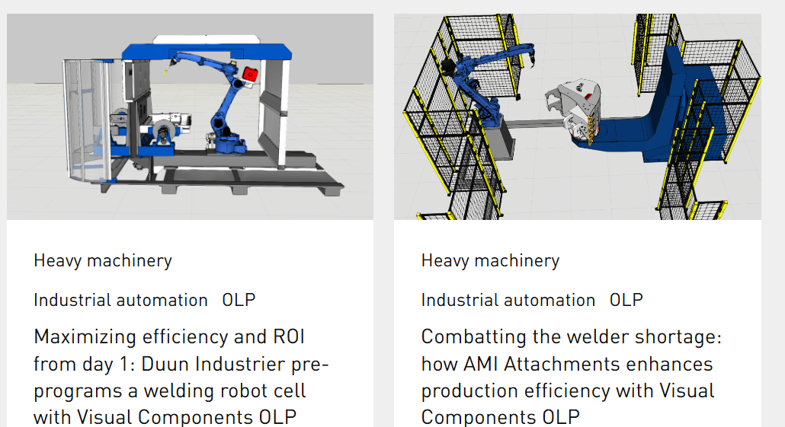
Digital Twins – Examples
For OEMs – models are sales tools.
  Post sale service is easier
Tools for integrating new technology
  https://www.visualcomponents.com/
    Production layouts and simulations (try before you buy)
  https://www.spatial-one.com/
  https://matterport.com/
  https://www.mappedin.com/
www.ocni.ca
Notes:
Digital Twin in Automotive: Companies are creating virtual vehicles and testing them at minimal cost. Digital twin automotive examples include recent case studies from Porsche, Mercedes, Volkswagen, and other companies.
Digital Twin in Aerospace: Airline manufacturers have achieved record improvement rates in first time quality.
Digital Twin in Manufacturing: Teams use AR/VR to solve supply chain issues before they arise. Manufacturing digital twins and construction digital twins have recently streamlined workflows in Amazon warehouses and other supply chain settings.
Digital Twin in Retail: Digital twins can help meet the demand for virtual reality shopping experiences.
Digital Twin in Semiconductors: The large files that make up semiconductors make digital twin semiconductor development particularly helpful.
Digital Twin in Healthcare: Digital twins can help healthcare professionals and researchers conduct trials, observe health outcomes over time, and make public health recommendations. Recent digital twin healthcare examples have been used by Cleveland Clinic.
Digital Twin Across Industries: Digital twin architecture can be used for collaboration, advanced visualization of complex systems, marketing, and much more.

Slide 30

AI
The Hype!
GenAI – ChatGPT, Copilot, Claude, Gemini...
They will take all the jobs!!! (or will they?)
Reality
It's been a long road getting here.
Much of the math started in 1940s (and some in the late 19th century) (History of Machine Learning – A Journey through the Timeline. )
Machine learning has been in industry for s
Numerous industrial applications
  Integrated with ERPs and MRPs (e.g. demand forecasting, throughput optimization)
  https://eigen.io/
  https://www.drsrobot.ca/en?pgid=lklgs96n-66dba18c-114a-43a2-8bd2-88638e3b76ef
www.ocni.ca
Notes:
Recall adaptive feedback welding
The early History of Machine Learning
1943: The First Neutral Network with Electric Circuit
1950: Turing Test
1952: Computer Checkers
1957: Frank Rosenblatt – The Perceptron
1967: The Nearest Neighbor Algorithm
1974: The Backpropagation
1979: The Stanford Cart
The AI Winter
The Rise of Machine Learning in History
1997: A machine defeats a man in chess
2002: Software Library Torch
2006: Geoffrey Hinton, the father of Deep Learning
2011: Google Brain
2014: Deepface
2017: ImageNet Challenge Milestone
Present: State-of-the-art Machine Learning
Robotics
Healthcare
Education
Future of Machine Learning
Quantum Computing
AutoML

Slide 31
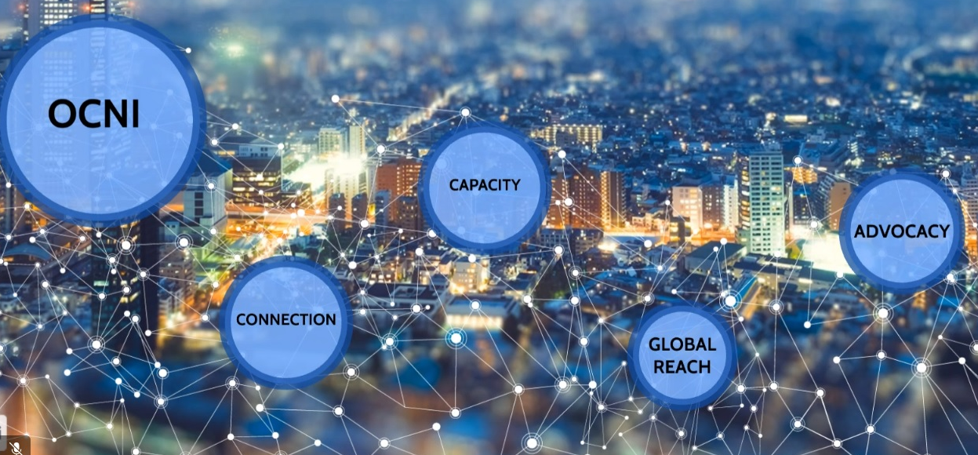



Contact Us
www.ocni.ca
905.839.0073
hello@ocni.ca
www.ocni.ca

